Slide 1
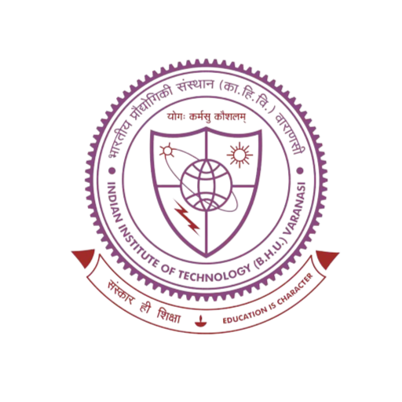

Exploratory Project
Department of Electrical Engineering ,IIT (BHU) Varanasi
Supervised By :
Prof. Dr. Santosh Kumar Singh

Slide 2

PHOTOVOLTAIC SYSTEM WITH DC TO DC BOOST CONVERTER(Using MPPT) AND THREE PHASE DC TO AC INVERTER
Submitted By :
Manvendra Singh Holkar(21085049)
Khushboo Chaurasya(21085039)
Mahima Chahar(21085045)

Slide 3
Table of Contents
1
Three phase DC to AC inverter
4
Introduction
Sinusoidal pulse width modulation
2
Simulation Result
5
DC to DC Boost Converter
Simulation on Matlab Software Simulink
3
MPPT
Conclusion
6
Perturbation and Observation method

Slide 4
Introduction :
1
Solar energy can be converted into electrical energy through the use of photovoltaic (PV) cells, also known as solar cells. These cells are made from semiconductor materials, such as silicon, and are designed to absorb sunlight and convert it into electricity.When sunlight hits a solar cell, it excites electrons in the semiconductor material, causing them to flow and generate a current.This current is then collected by conducting wires and can be used as electrical energy.
2
1
The efficiency of solar cell conversion depends on factors such as the quality of the semiconductor material, the amount of sunlight that is absorbed, and the temperature of the cell. Additionally, solar panels can be connected in series or parallel to increase the overall voltage or current output, respectively.
3

Slide 5
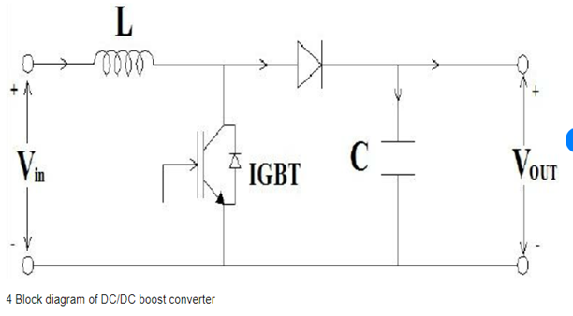
2
DC to DC Boost Converter
A boost converter is a type of DC-DC converter that steps up the voltage of a DC input to a higher DC output voltage. It is called a "boost" converter because it boosts the input voltage to a higher level. Boost converters are commonly used in applications where a higher voltage is needed than the available input voltage.
Components Required
1.Voltage Source
2.Inductor
3.1N4001 Diode
4.Switching Device(IGBT)
5.Capacitor
6.Load

Slide 6
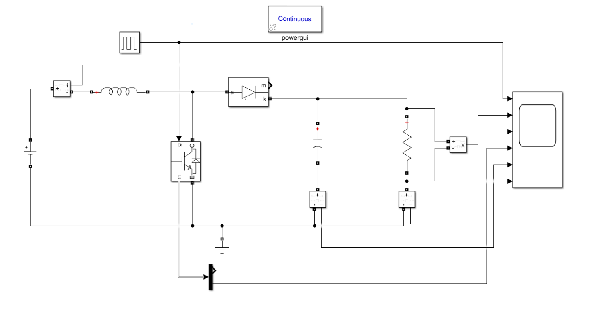
Circuit Diagram of DC to DC Boost converter

Slide 7
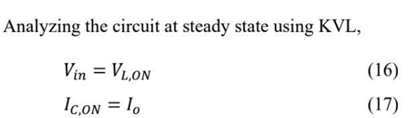
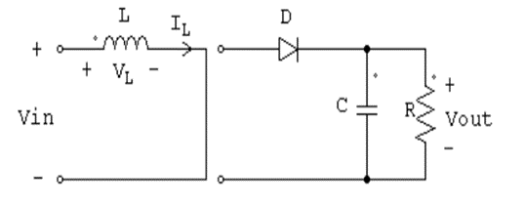
a
Mode 1: Switch is On, Diode is Off
Mode 1 begins when the switch SW is turned on at t = 0. The input current which rises flows through inductor L and switch SW. During this mode, energy is stored in the inductor and load is supplied by capacitor current.

Slide 8
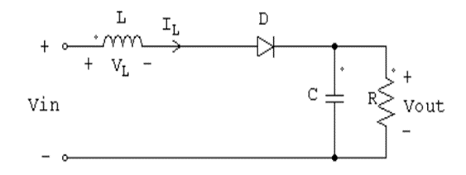
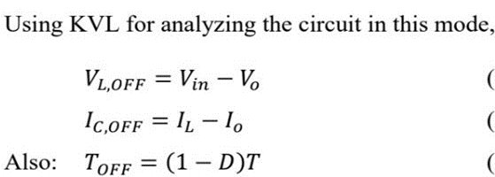
b
Mode 2: Switch is Off ,Diode is On
Mode 2 begins when the switch is turned off at t = DT. The current that was flowing through the switch would now flow through inductor L, diode D, output capacitor C, and load R. The inductor current falls until the switch is turned on again in the next cycle. During this time, energy stored in the inductor is transferred to the load together with the input voltage. Therefore, the output voltage is greater than the input voltage

Slide 9
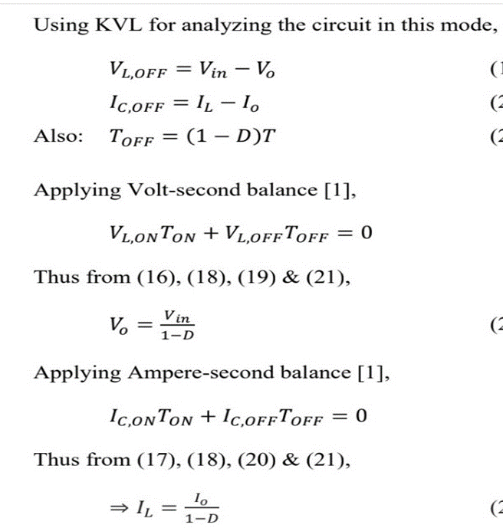

Slide 10
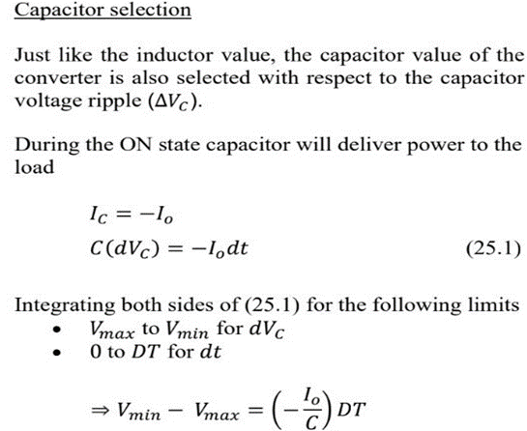
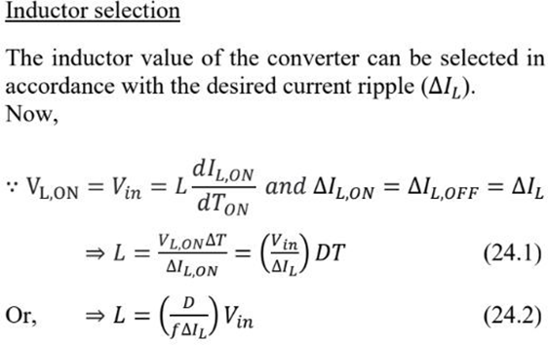
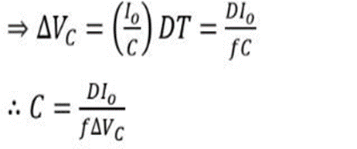
1
3
2

Slide 11
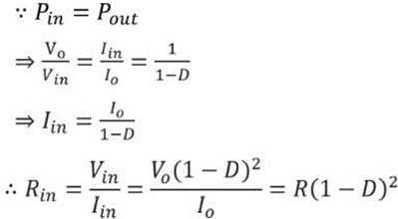
3
MPPT(Maximum Power Point Tracking) :
MPPT or Maximum Power Point Tracking is algorithm that included in charge controllers used for extracting maximum available power from PV module under certain conditions. The voltage at which PV module can produce maximum power is called „maximum power point‟ (or peak power voltage). Maximum power varies with solar radiation, ambient temperature and solar cell temperature.Using the fact that input power is equal to output power , we can get :
Hence by the maximum power transfer
theorem, maximum power will extracts from the solar panel when transferred load resistance is equal to the internal resistance. This condition is achieved by this proposed (MPPT) algorithm.
Where,The proposed control strategy will set the duty cycle of converter so as to match transferred load resistance with internal resistance of solar panel.

Slide 12
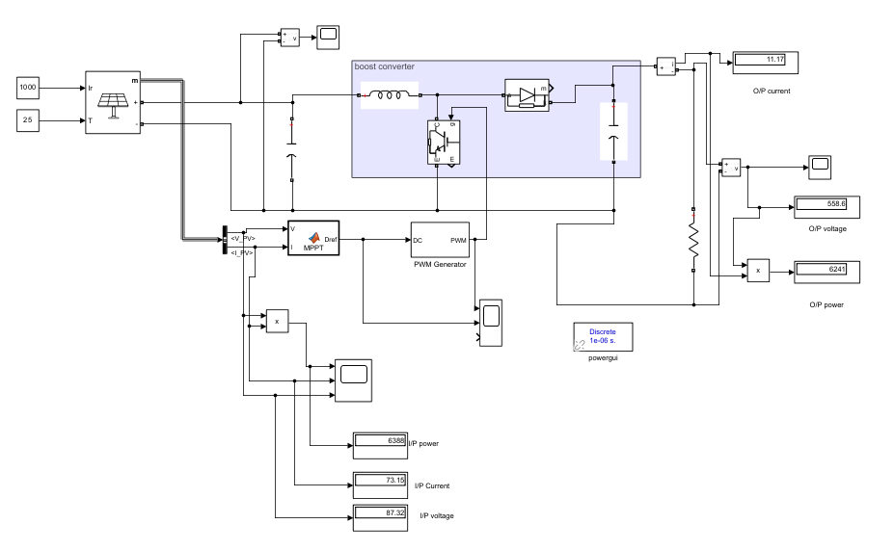

Circuit Diagram of Solar PV array with DC to DC Boost converter and MPPT
a

Slide 13
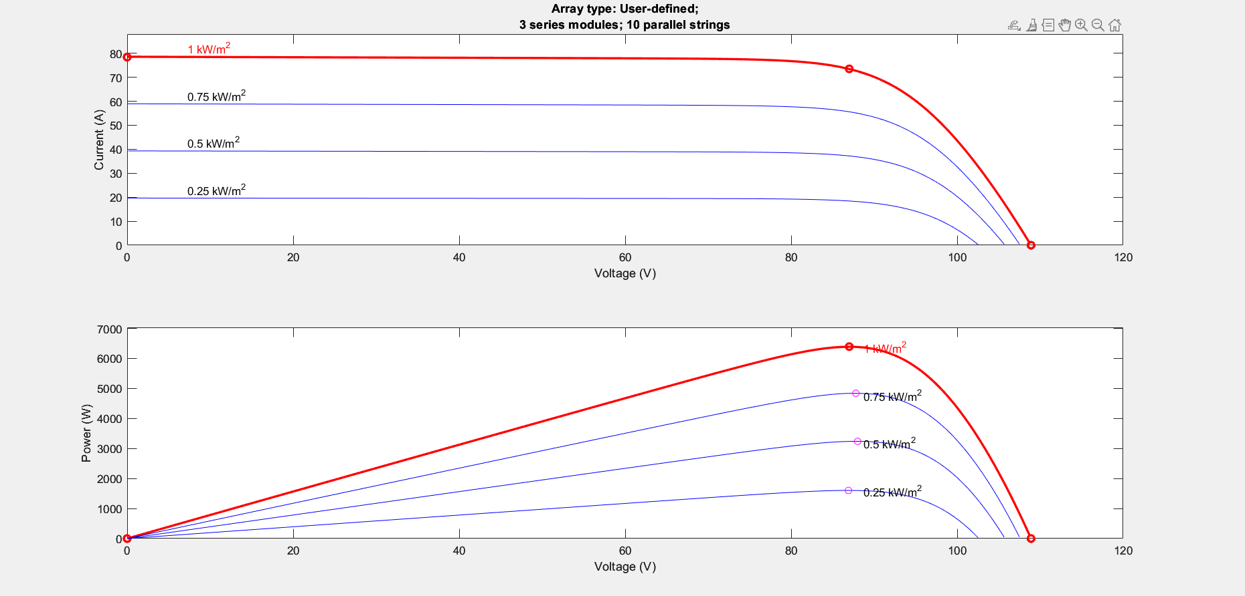

Simulation Result : I-V Characteristic Curve and P-V Characteristic Curve
b

Slide 14
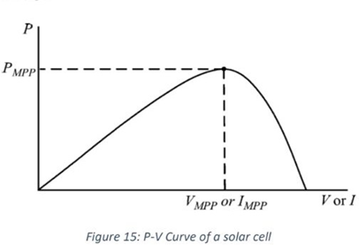
Perturbation and Observation Method:
c
When we observe the PV curve , We ﬁnd out that :In the given curve, D = 1.0 at the origin, and D = 0.0 at thus, the value of D decreases as we move from left to right in the curve. Now, we can divide the power curve into 2 parts for analysis. The part to the left of the maximum power point, and the part to the right of it. In the left part, the power output increases as we increase the voltage, or in other words, the power output increases with a decrease in the value of D.
Contrast to this, in the right part of the curve, the increasing voltage (or the decreasing D) leads to a decrease in the power output.From this Observation P and O method come.

Slide 15

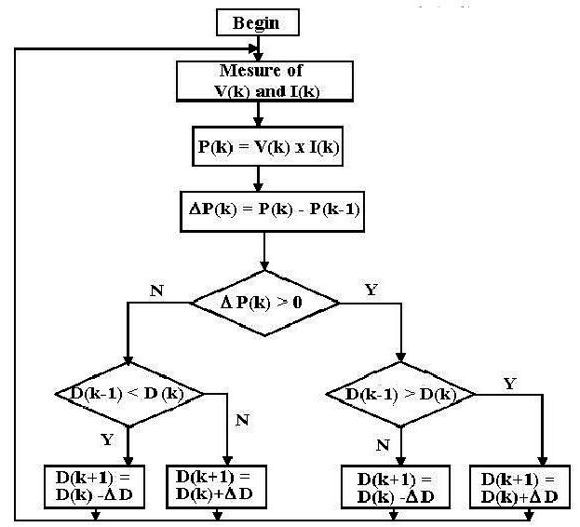
Flow Chart of Perturb and Observe Method.
d

Slide 16
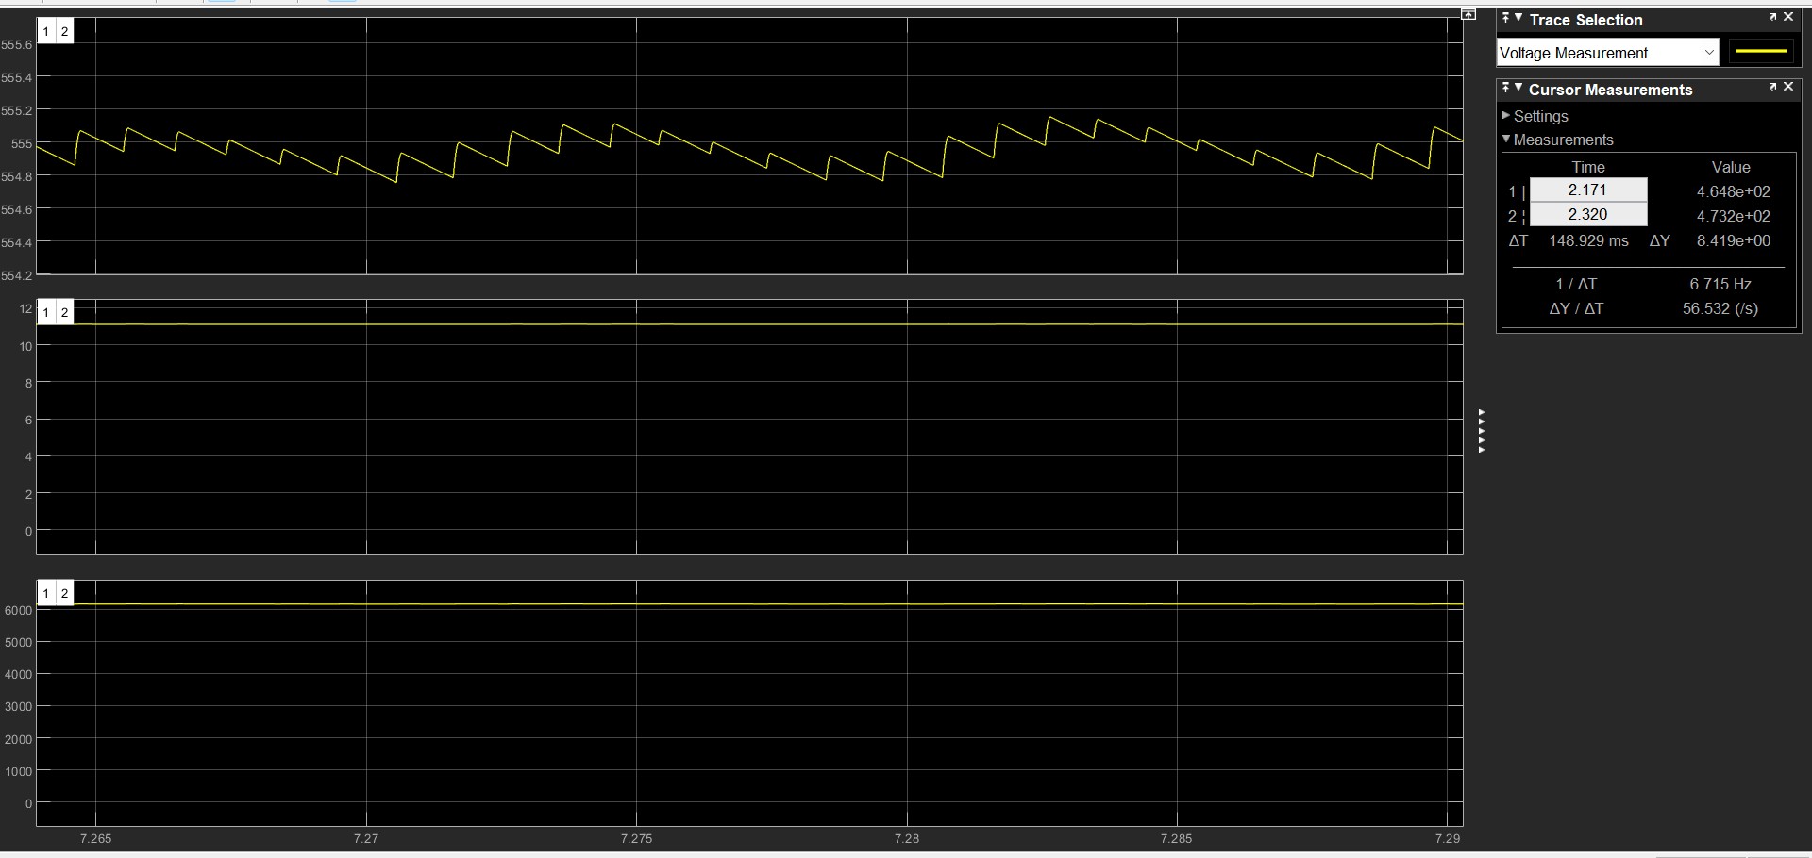
PV array voltage, PV array current, Output power of PV array
e

Slide 17
Three phase DC to AC inverter
4
A three-phase DC to AC inverter is a device that converts DC (Direct Current) power into AC (Alternating Current) power with three-phase output. The inverter is used in various applications, including renewable energy systems, motor control, uninterruptible power supply, and many others.
There are different types of three-phase DC to AC inverters, including pulse width modulation (PWM) inverters, sinusoidal pulse width modulation (SPWM) inverters, and multilevel inverters. PWM inverters are the most common type of inverter used in industrial applications due to their simplicity and cost-effectiveness. SPWM inverters are preferred for applications requiring a high-quality output waveform, such as motor control.

Slide 18
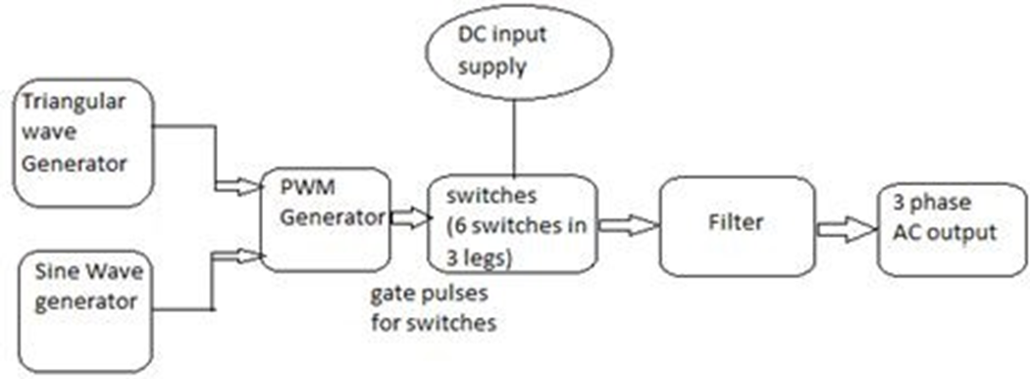
SINUSOIDAL PULSE WIDTH MODULATION (SPWM)
a
The gating signals are generated by comparing a sinusoidal reference wave with a triangular carrier wave of frequency Fr and Fc respectively. When the sinusoidal wave has a higher magnitude, output is high otherwise it is low. The comparator output is processed in a trigger pulse generator in such a way that the output voltage wave has a pulse width in agreement with comparator pulse width.

Slide 19
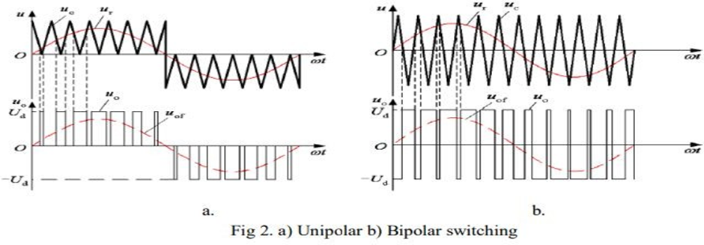
SWITCHING TECHNIQUES
b
To provide the gate signals to the switches in an inverter, two types of switching schemes are used-Unipolar and Bipolar voltage switching. If the triangular carrier wave is either in the positive or negative polarity range of changes, the resulting SPWM wave lies only in the polarRange, this type of switching is called unipolar control mode. Whereas if the triangular carrier wave lies in continuous range between both positive and negative polarity, the SPWM wave lies between positive and negative changes, this switching is known as bipolar control.

Slide 20
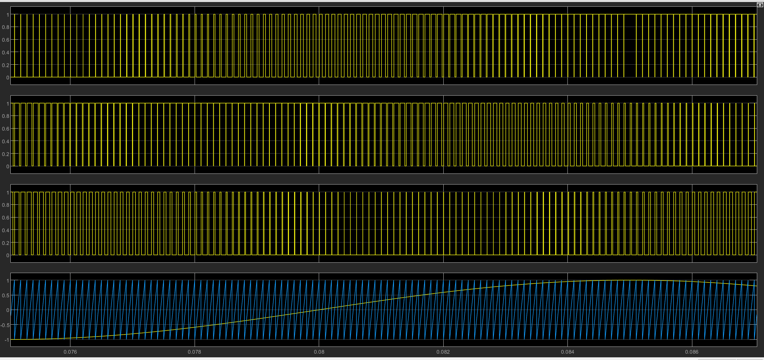
SWITCHING TECHNIQUES IN THREE PHASE INVERTER
c
Here, triangular carrier wave is compared with three reference sinusoidal waves (U,V,W) which are displaced by 120 degrees.

Slide 21
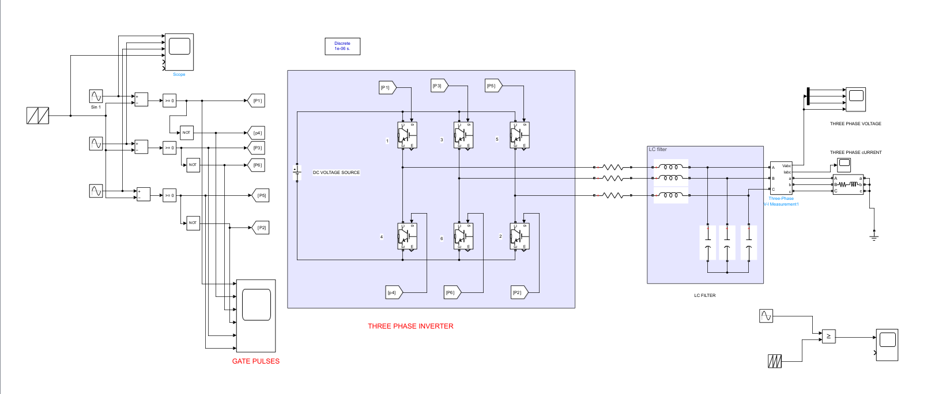

Simulink Model for SPWM Inverter with LC ﬁlter
d

Slide 22
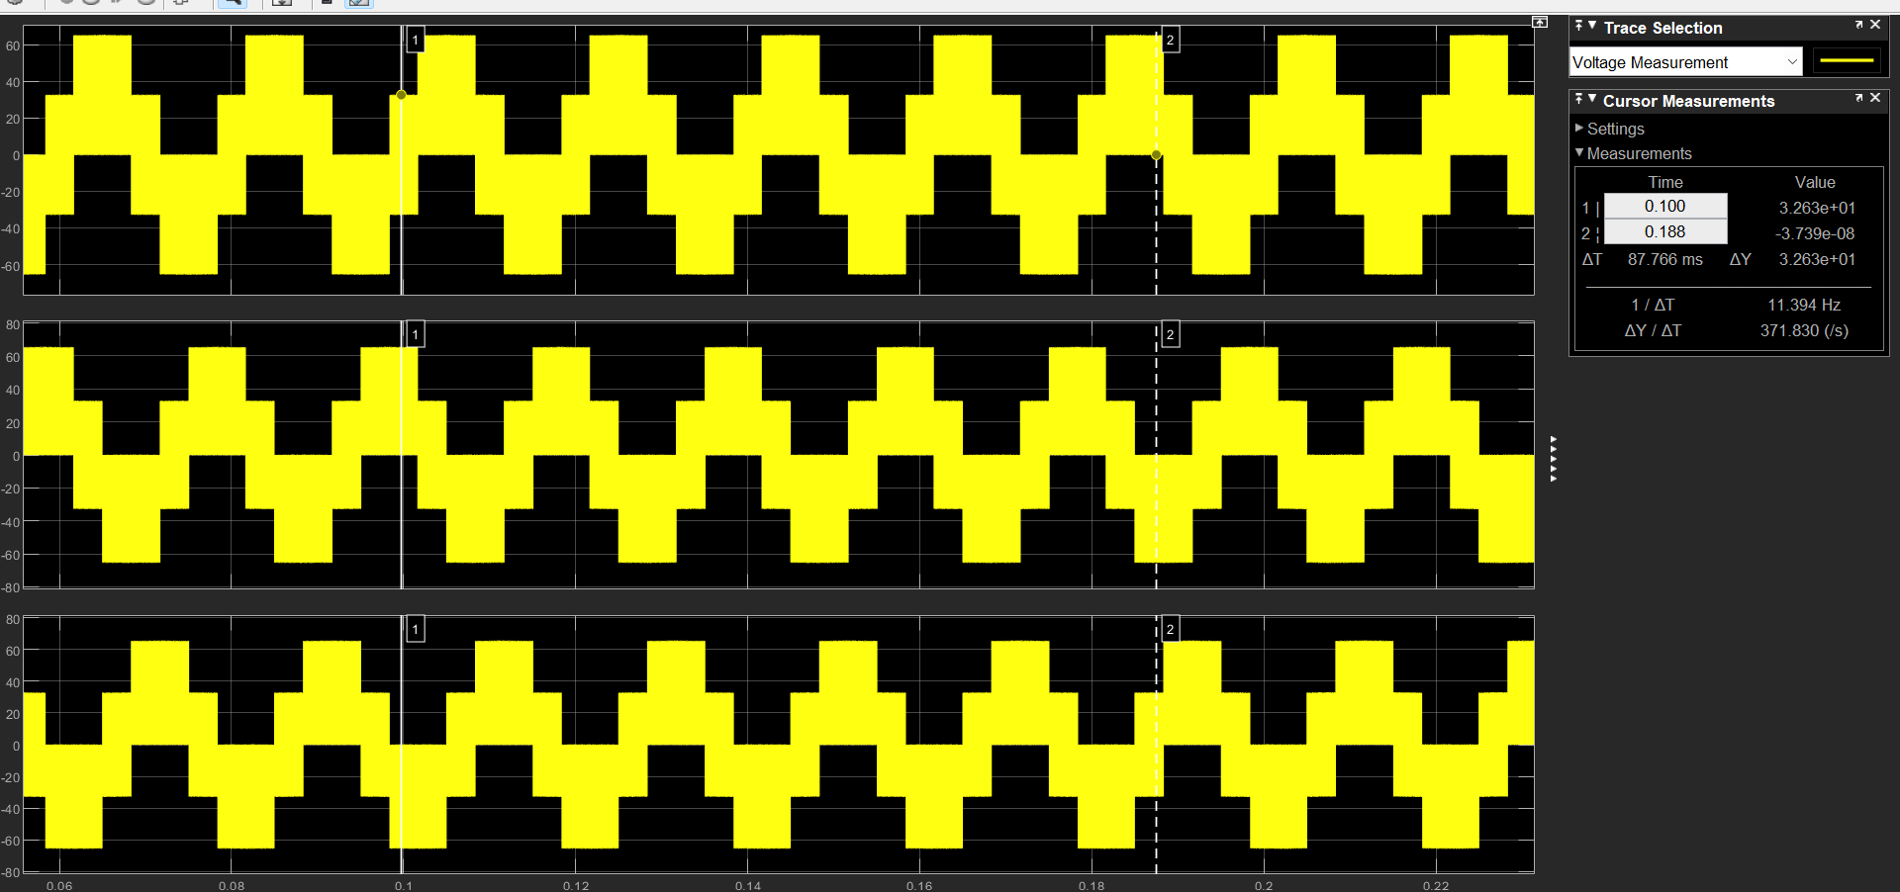
SIMULATION RESULTS
5
a
Phase to Ground voltage vs time(Before LC Filter)

Slide 23
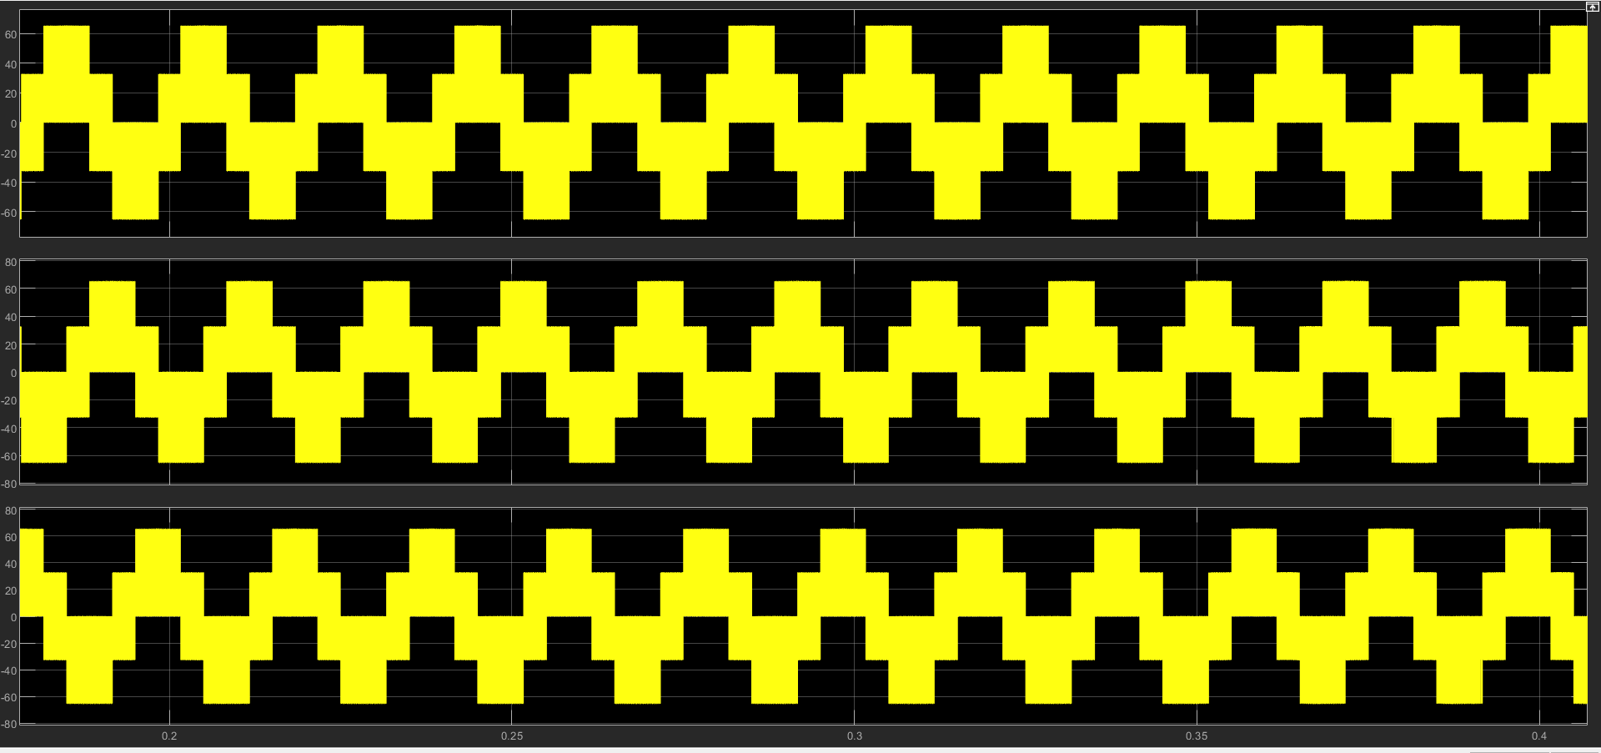
b
3 Phase Output Current vs time(Before LC Filter)

Slide 24
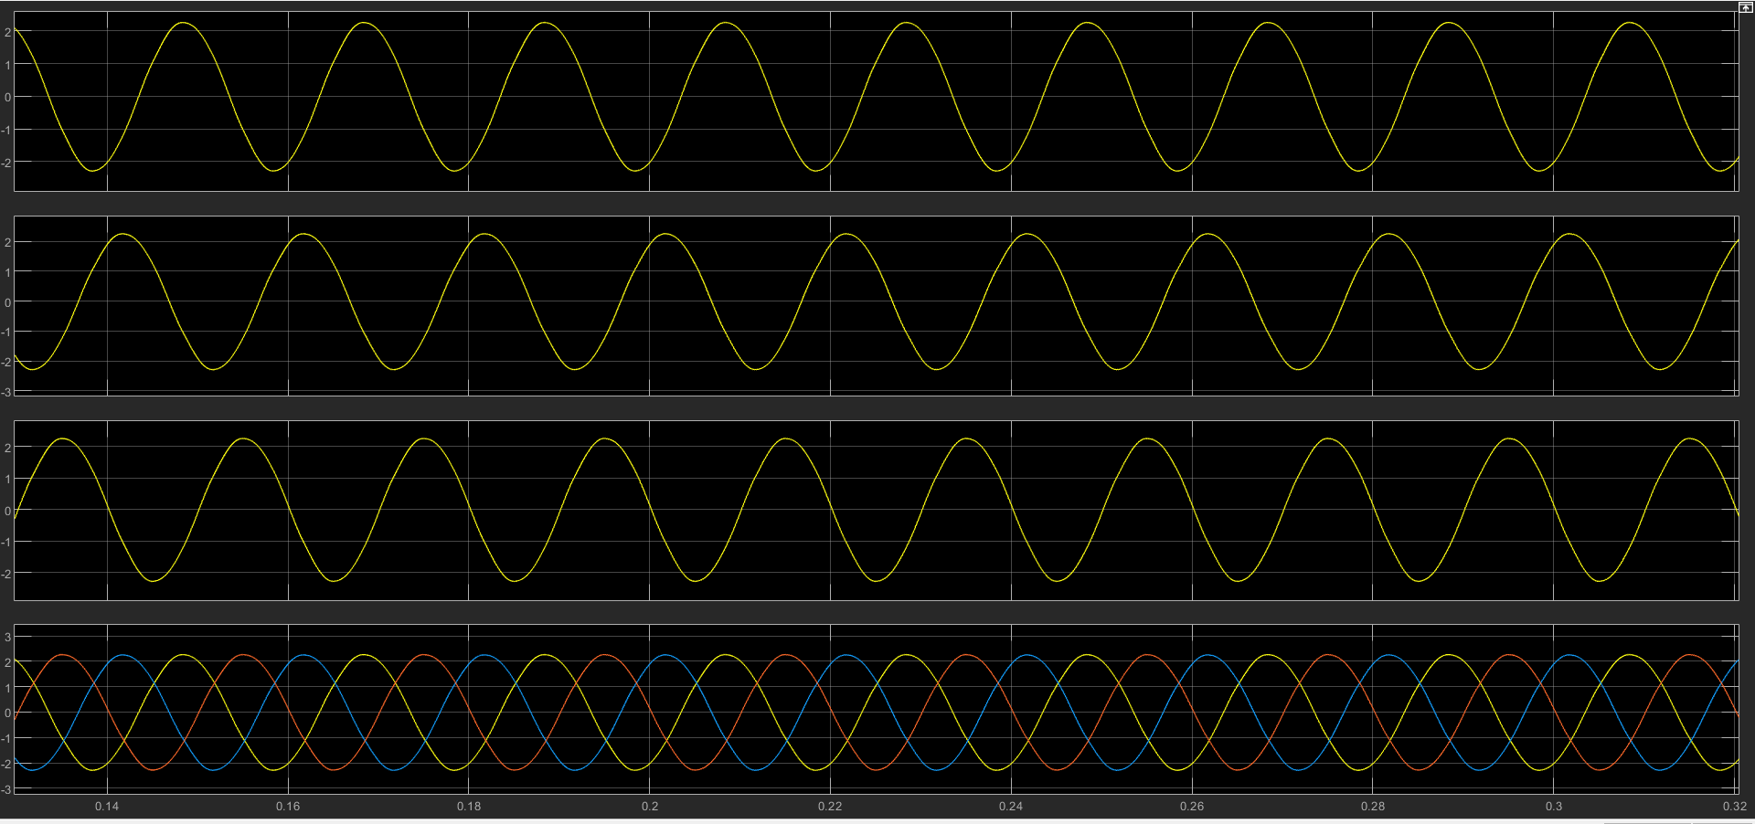
c
Phase to Ground voltage vs time(After LC Filter)

Slide 25
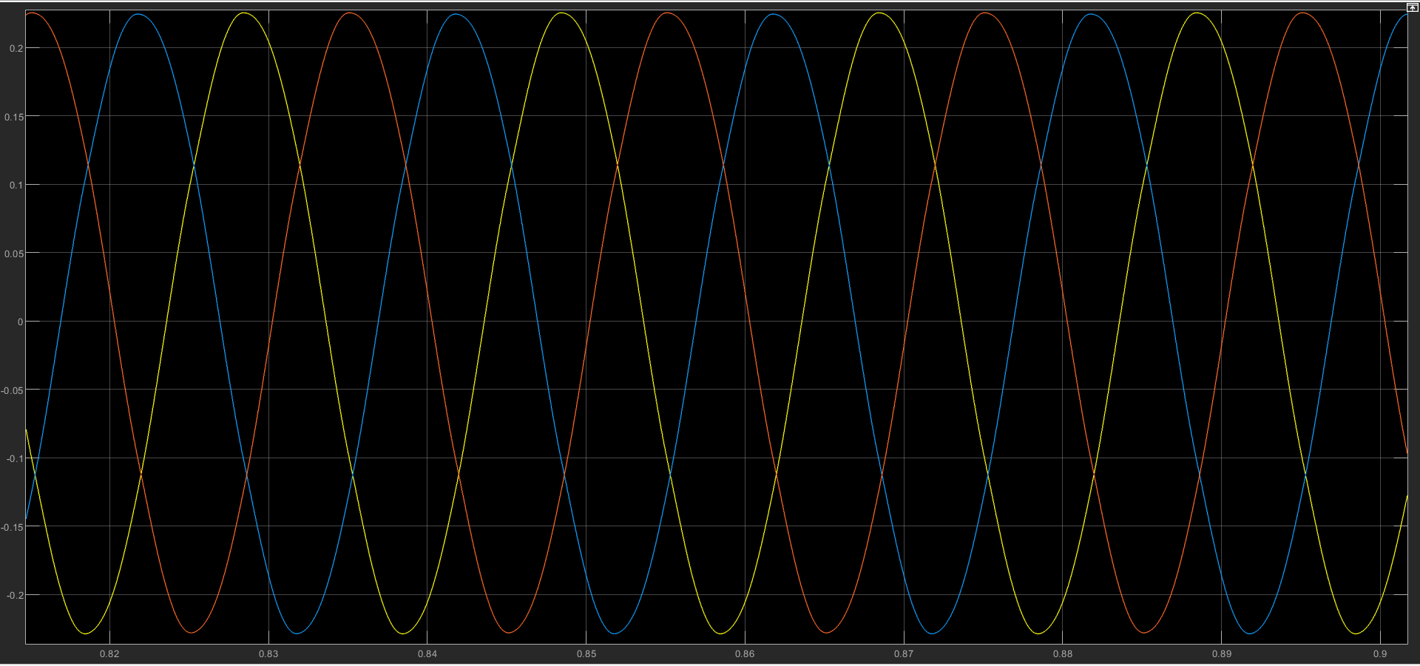
d
3 Phase Output Current vs time(After LC Filter)

Slide 26
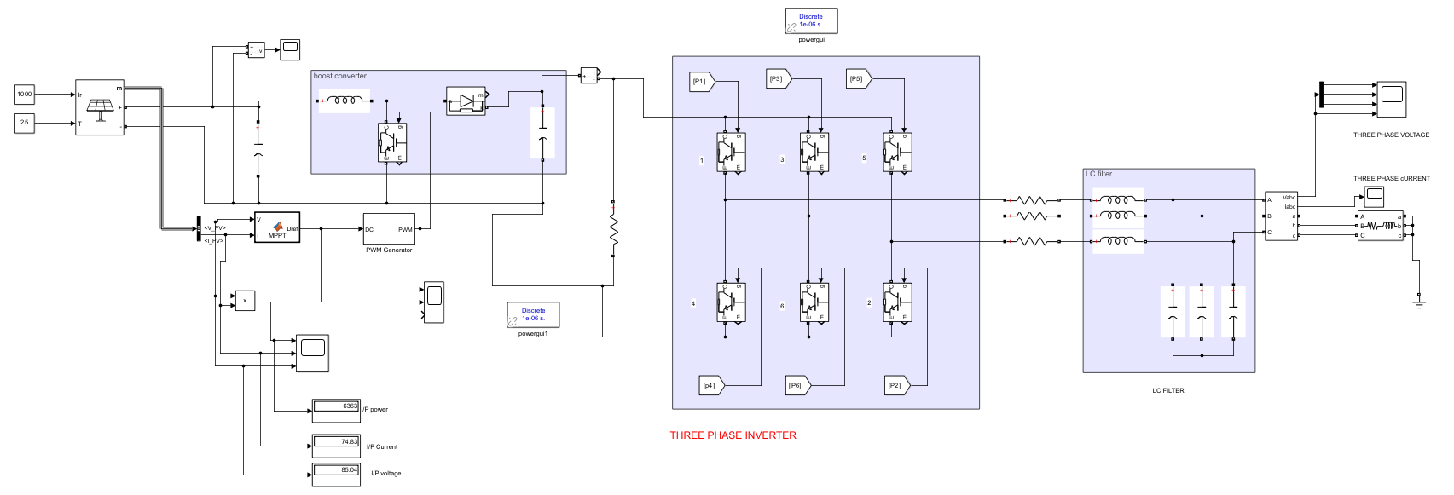
FULL CIRCUIT FOR THREE PHASE AC POWER GENERATION

Slide 27
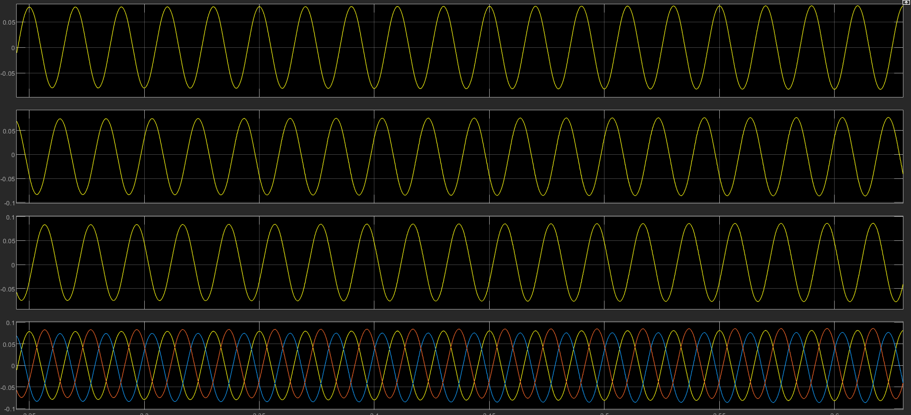
VOLTAGE OUTPUT OF THREE PHASE SPWM

Slide 28
6
Conclusion
In conclusion, a photovoltaic system with a DC to DC boost converter (using MPPT) and a three-phase DC to AC inverter is an efficient and effective way to convert solar energy into usable electricity. The DC to DC boost converter with MPPT maximizes the energy harvested from the solar panels and regulates the voltage to match the requirements of the inverter. The three-phase DC to AC inverter converts the DC power into three-phase AC power with a high level of efficiency and quality waveform.
This system is suitable for various applications, including residential, commercial, and industrial, and it can help reduce dependence on grid electricity and lower electricity bills. The system's performance can be further improved by using high-quality components and optimizing the system design to match the specific requirements of the application. Overall, this system is a reliable and sustainable solution for converting solar energy into usable electricity.

Slide 29
H
N
T
A
K
Y
U
O

